Slide 1


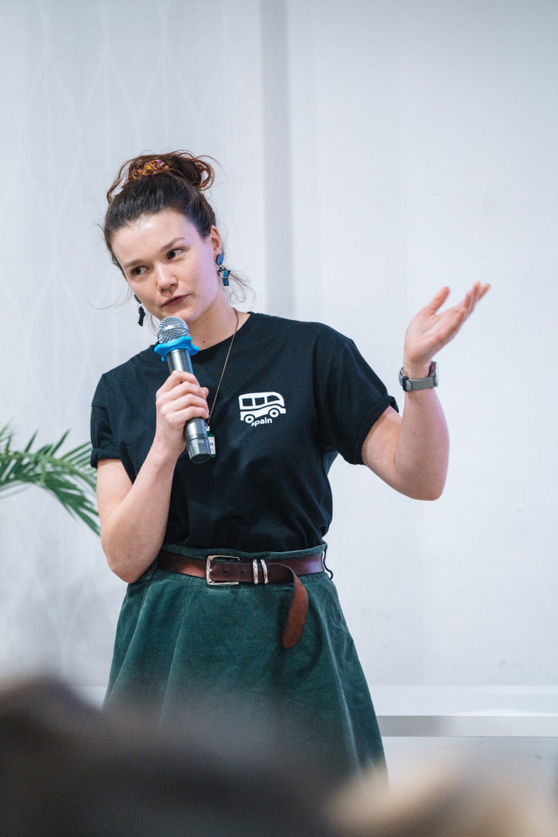
Introduction to Machine Learning using open data Barcelona, 16th of May 2024
with Anaïs Pepey
and Asia Noble

Slide 2
Agenda
TODAY’S PLAN
INTRODUCTION
ML & AI fundamentals
Use cases
Malaria
Resources
WORKSHOP
Live Code
Python basics
Guided ML analysis
On your own! [optional]
Notes:
Disclaimer! I’m new, and it’s a recent and evolving field! Many definitions exist, and my own bias affect the ones I choose

Slide 3

Introduction – Machine Learning
DEFINITIONS
Artificial Intelligence (AI)
methods enabling machines to perceive their environment and uses learning and intelligence to take actions that maximise their chances of achieving defined goals
computer vision
natural language processing
generative AI
Responsible & ethical AI?
Trust in AI?

Slide 4
Introduction – Machine Learning
DEFINITIONS
Machine Learning (ML) – a branch of AI
development and study of statistical algorithms that can learn from data and generalise to unseen data
can perform tasks without explicit instructions
Decision process
Error function
Model optimisation process
Random forest
Linear & logistic regressions
Neural networks

Slide 5
Introduction – Machine Learning
FUNDAMENTALS
What is the difference between ML and AI?
AI
the broader concept of creating systems that can mimic human intelligence
ML
a specific approach within AI that focuses on using algorithms to learn from data and make decisions
not all AI applications use ML

Slide 6
Introduction – Machine Learning
FUNDAMENTALS
Observations
Initial dataset
Age (years) | Height (cm)
0 | 40
5 | 90
15 | 160
20 | 165
Features
Target
x
y
input
output
preprocessing

Slide 7
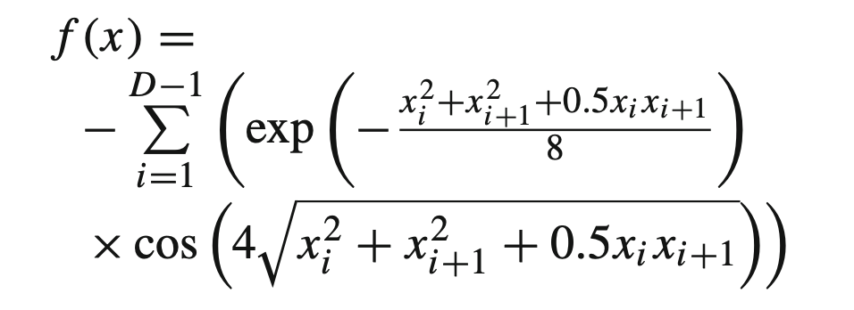
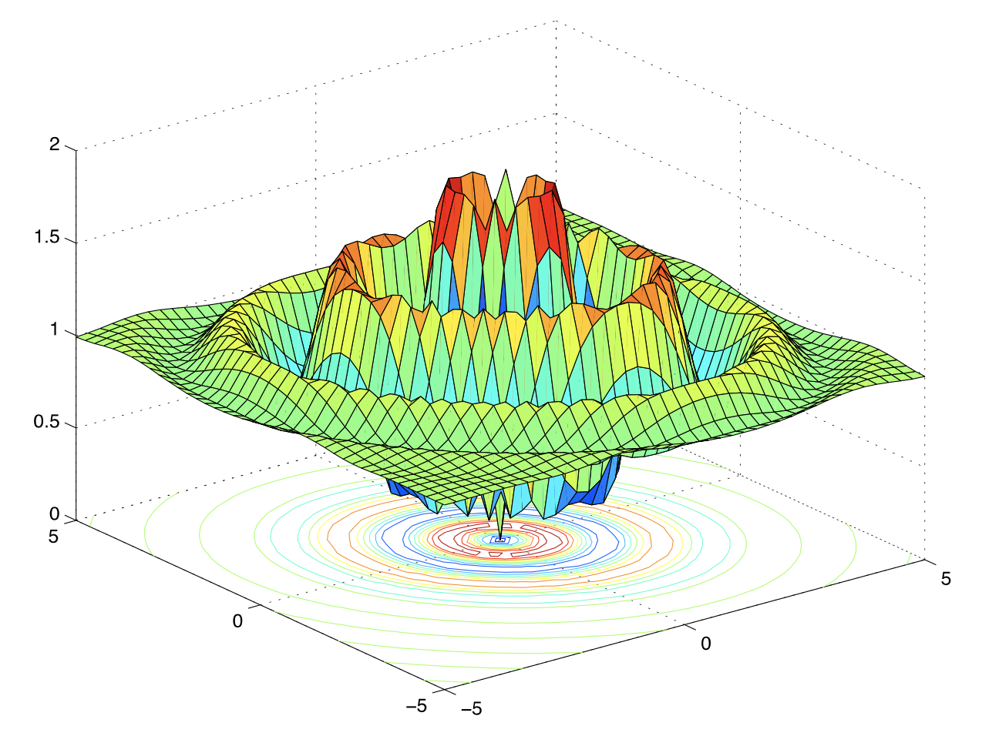
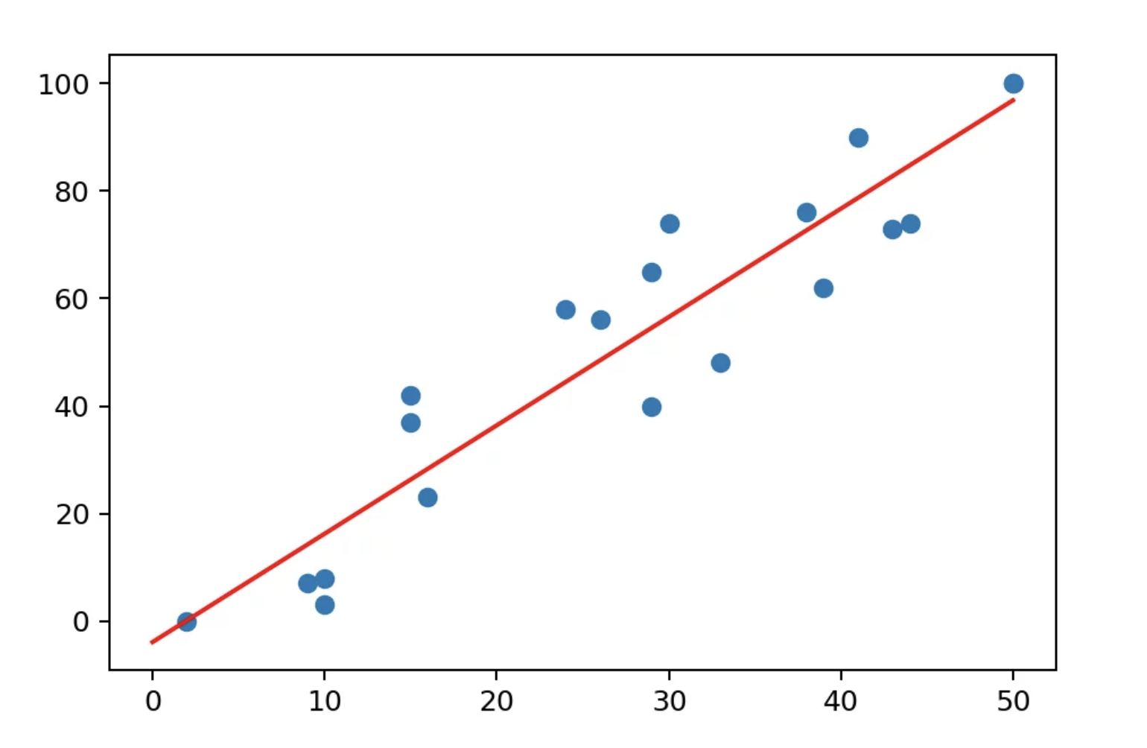
Introduction – Machine Learning
FUNDAMENTALS
Observations
Math function
easy complex
linear regression
multidimensional optimisation functions
Notes:
Most used? The one on the left

Slide 8
Introduction – Machine Learning
FUNDAMENTALS
Observations
Prediction
Age (years) | Height (cm)
0 | 40
5 | 90
15 | 160
20 | 165
25 | ?
Math function
Extrapolate

Slide 9
Introduction – Machine Learning
FUNDAMENTALS
Observations
Error:
difference between prediction and reality
Math function
Extrapolate
Evaluate

Slide 10
Introduction – Machine Learning
FUNDAMENTALS
Observations
Math function
Extrapolate
Evaluate
Improve

Slide 11
Introduction – Machine Learning
FUNDAMENTALS
Observations
Math function
Extrapolate
Evaluate
Improve

Slide 12
Introduction – Machine Learning
FUNDAMENTALS
Observations
Math function
Extrapolate
Evaluate
Improve

Slide 13
Introduction – Machine Learning
MODEL EVALUATION
Visually explained:
Ordinary Least
Squares Regression
setosia.io

Slide 14
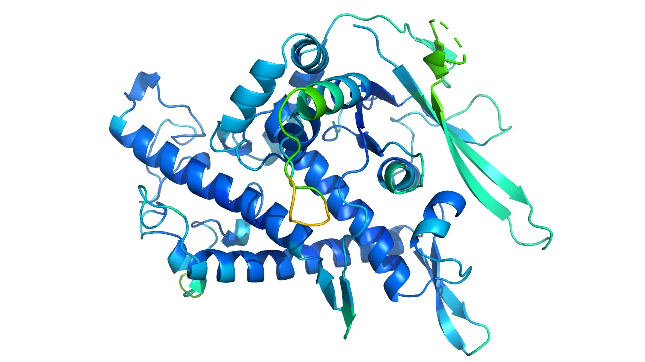
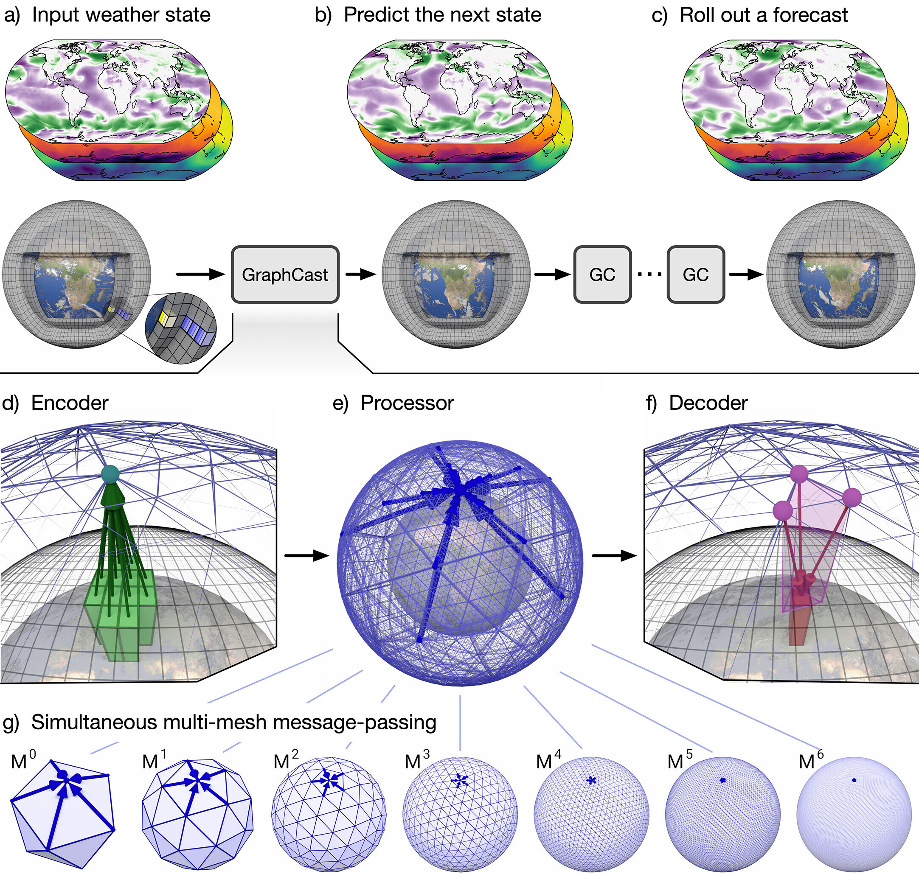

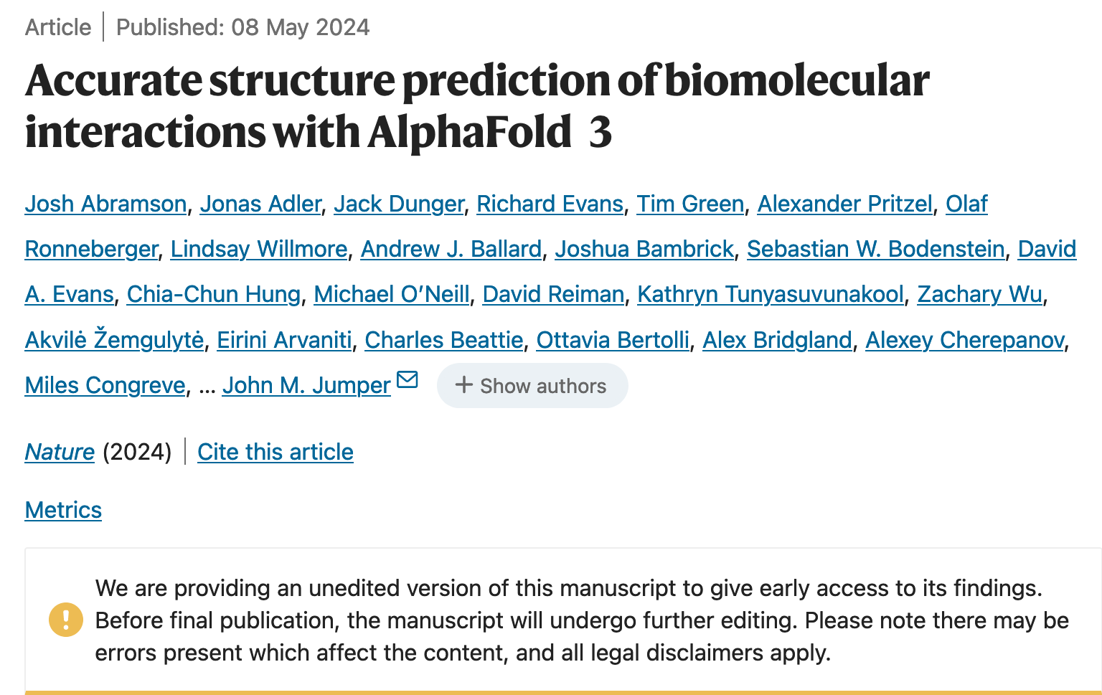
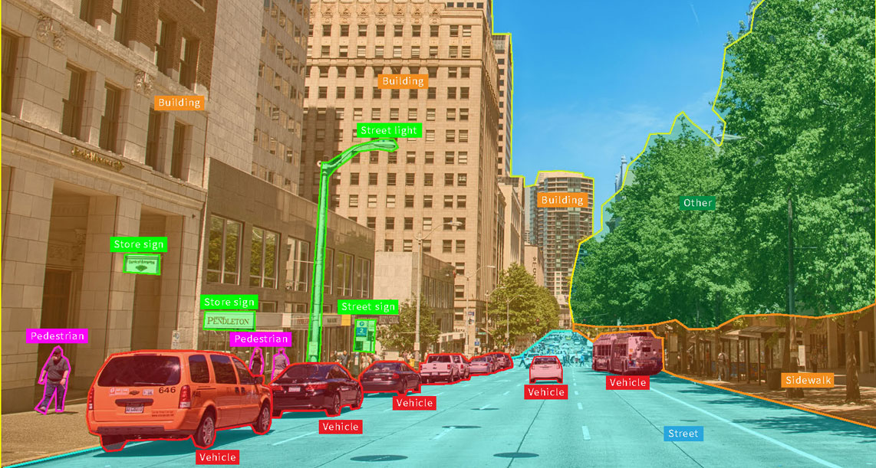

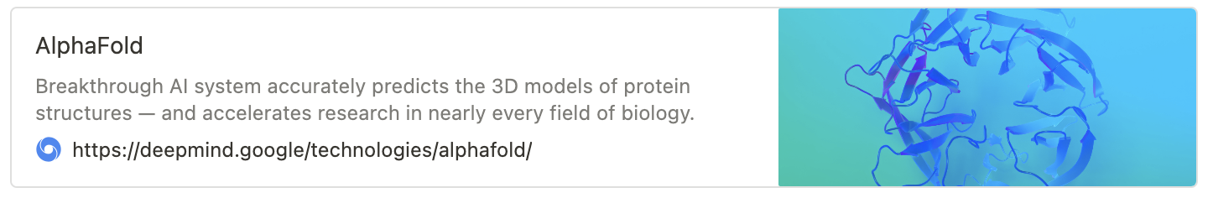
Introduction – Machine Learning
USE CASES
ML is already part of our daily lives
Speech recognition, LLMs
Computer vision
Medical applications
Climate change modelling
Infectious diseases surveillance
Notes:
wearable tech, diagnosis, molecular discovery, protein folding…

Slide 15
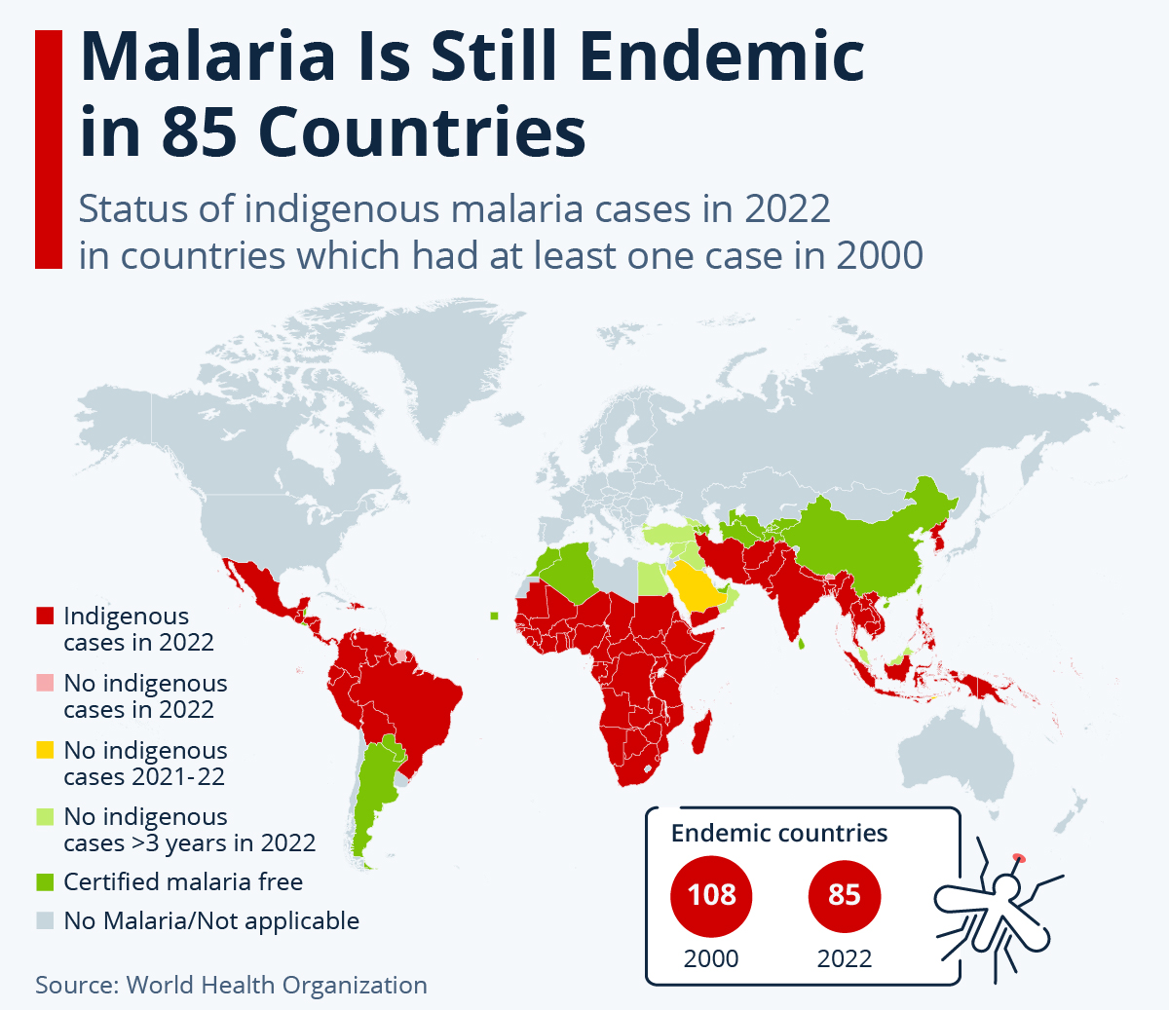
Introduction – Malaria
A GLOBAL ISSUE
THE DISEASE
Key points
acute febrile illness
vector-borne disease
preventable and treatable disease
half of the world's population at risk
no completely preventive vaccine available
Notes:
Vaccines:
RTS,S/AS01 and R21/Matrix-M
Since 2021
Only Pf, only children under 5
Only 13% mortality drop
Medicine:
artemisinin-based combination therapy (ACT)

Slide 16
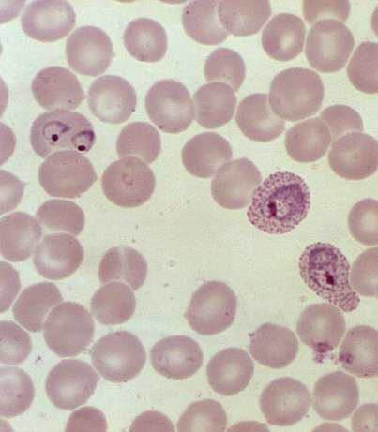
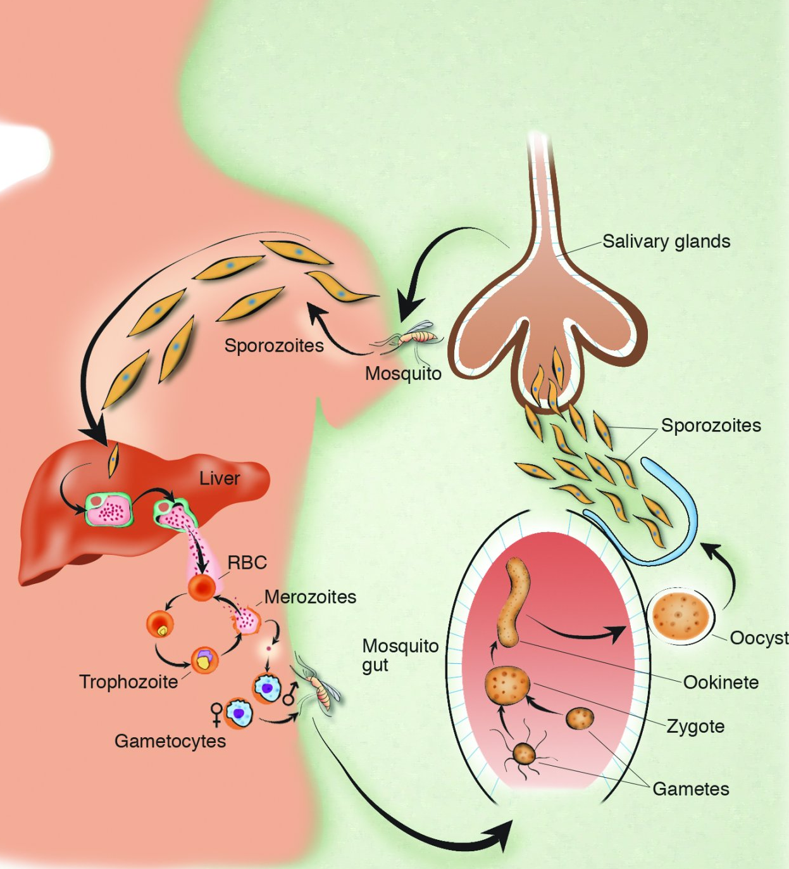
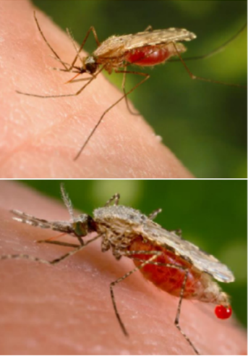
Introduction – Malaria
BIOLOGY
THE DISEASE
The parasite, Plasmodium spp
5 species
The vector, Anopheles spp
475 species, 70 identified as vectors
The host
Infected through a female Anopheles bite
Symptomatic and asymptomatic infections
Blood smear with P. vivax trophozoites
Malaria life cycle
An. minimus and An. stephensi
Notes:
>3000 species of mosquitoes

Slide 17
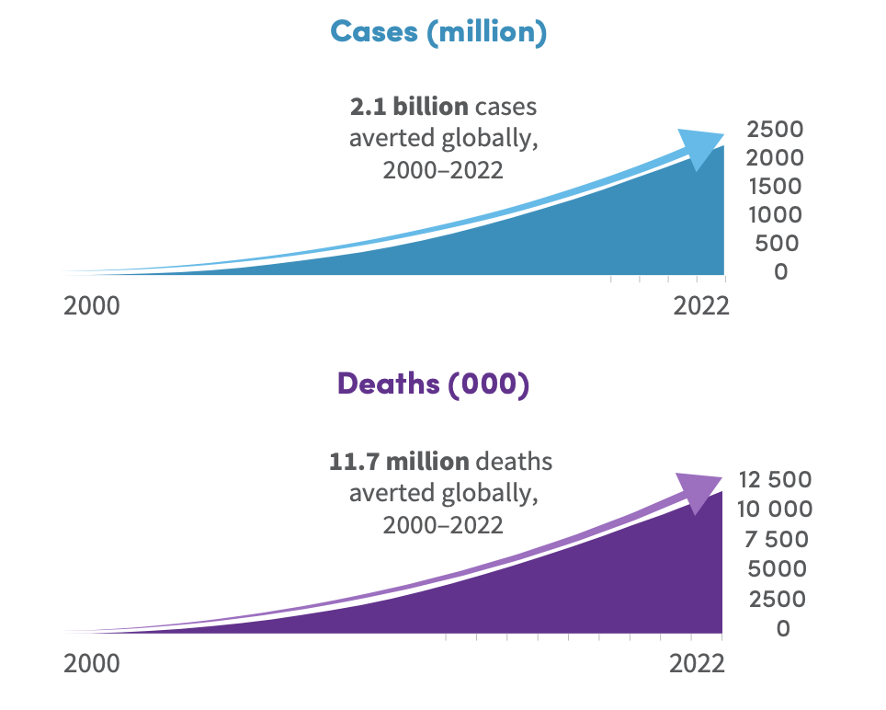
Introduction – Malaria
INCIDENCE
WHO malaria world report 2023
250 million cases
600,000 associated deaths
Decrease since the 2000s
Small increase since COVID

Slide 18
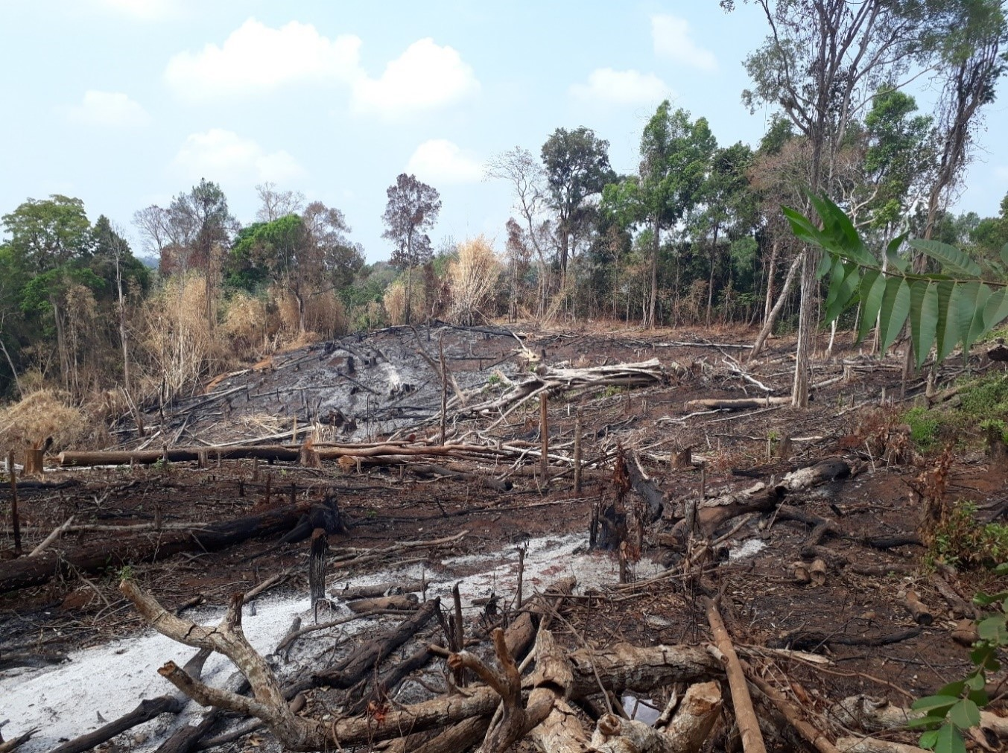
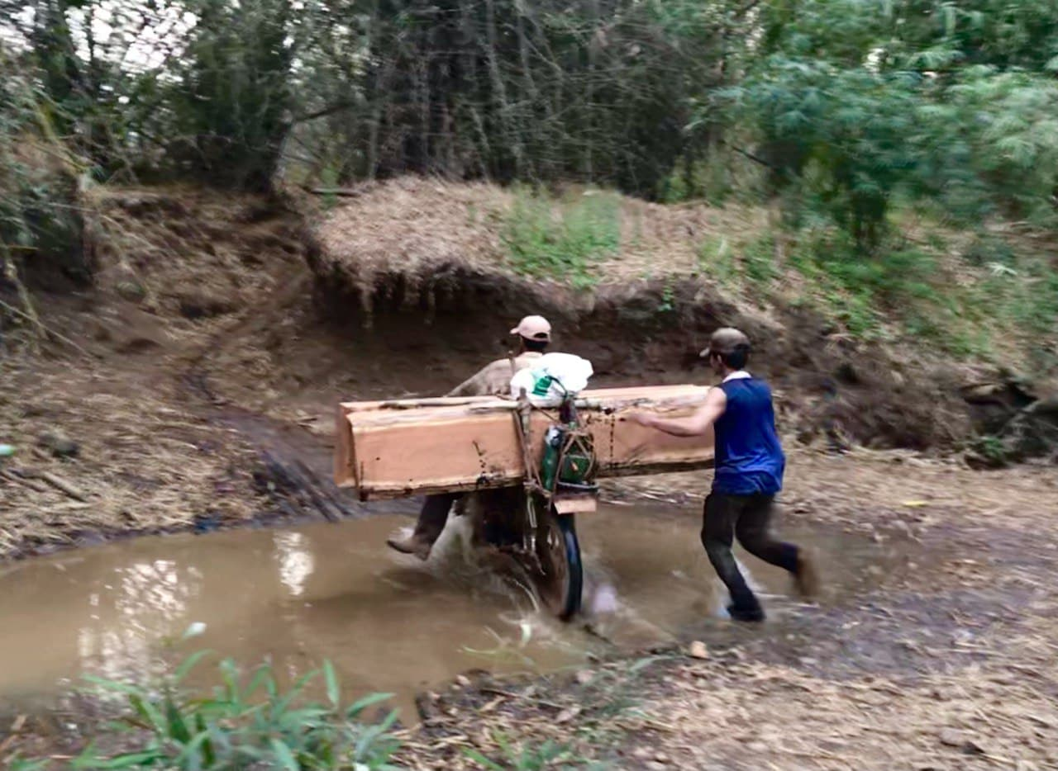
Introduction – Malaria
EPIDEMIOLOGY
Transmission depends on local characteristics
Environmental conditions
precipitations, temperature, humidity
deforestation, agriculture
Socio-economic factors
main income, households characteristics
vector control tools, diagnosis and treatment
knowledge about malaria
Khmer wood loggers
Patch of forest cleared after ‘slash and burn’

Slide 19
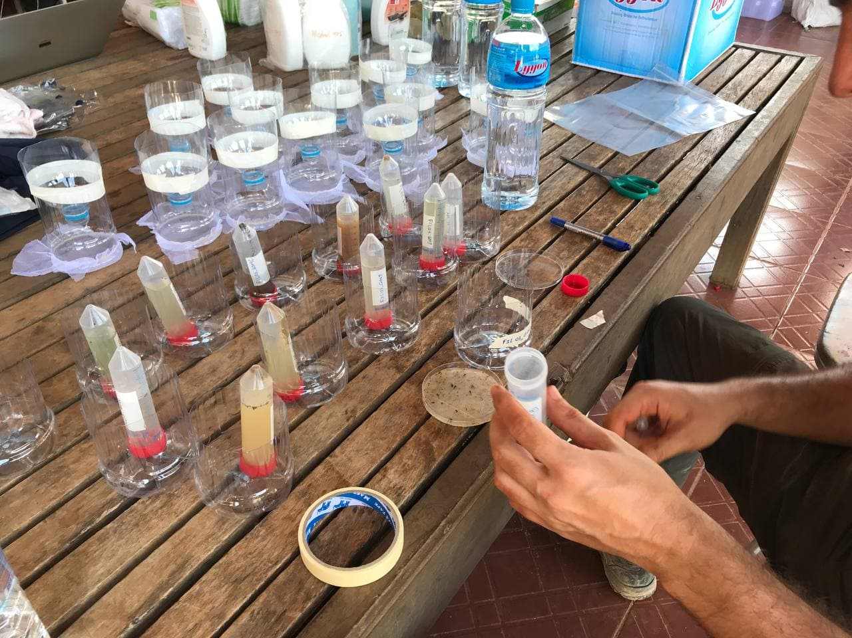
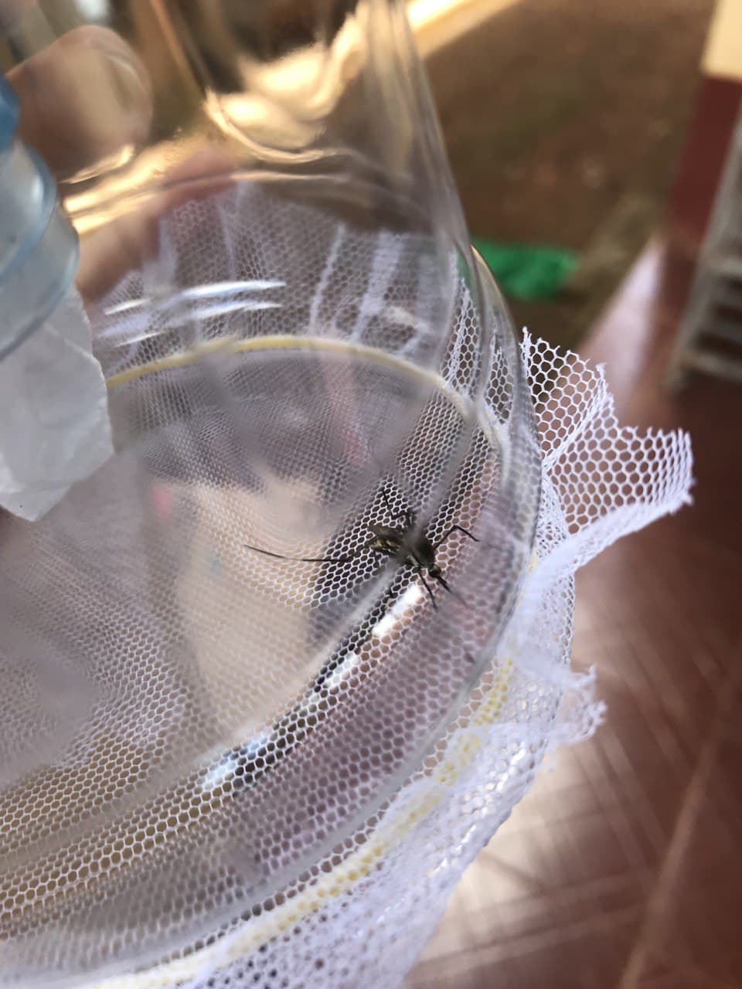
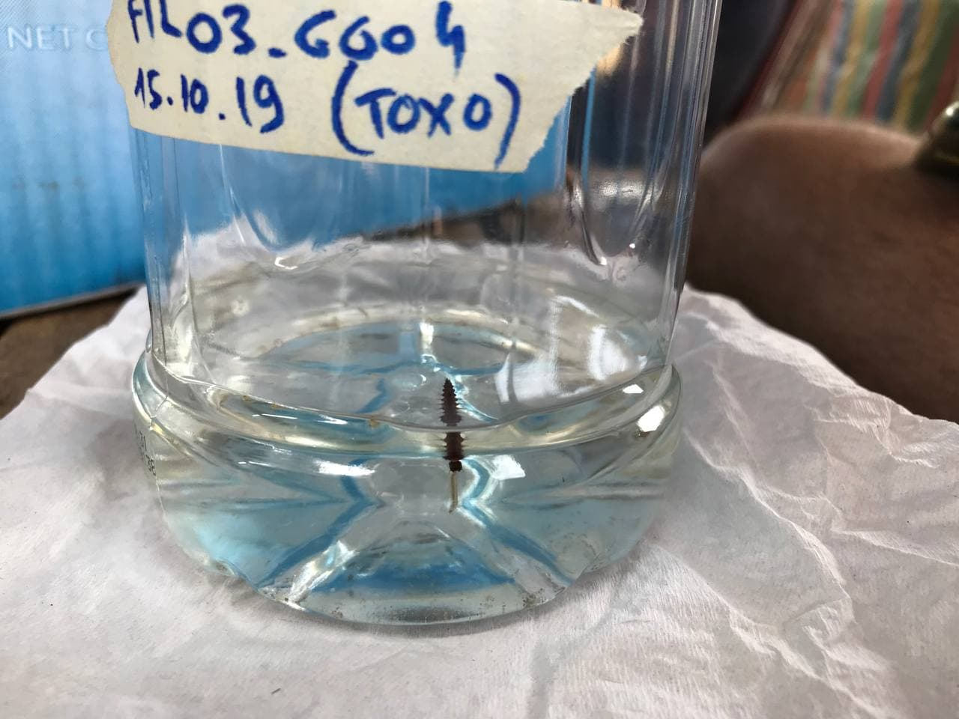
Workshop
RESOURCES: PHD RESEARCH

Slide 20
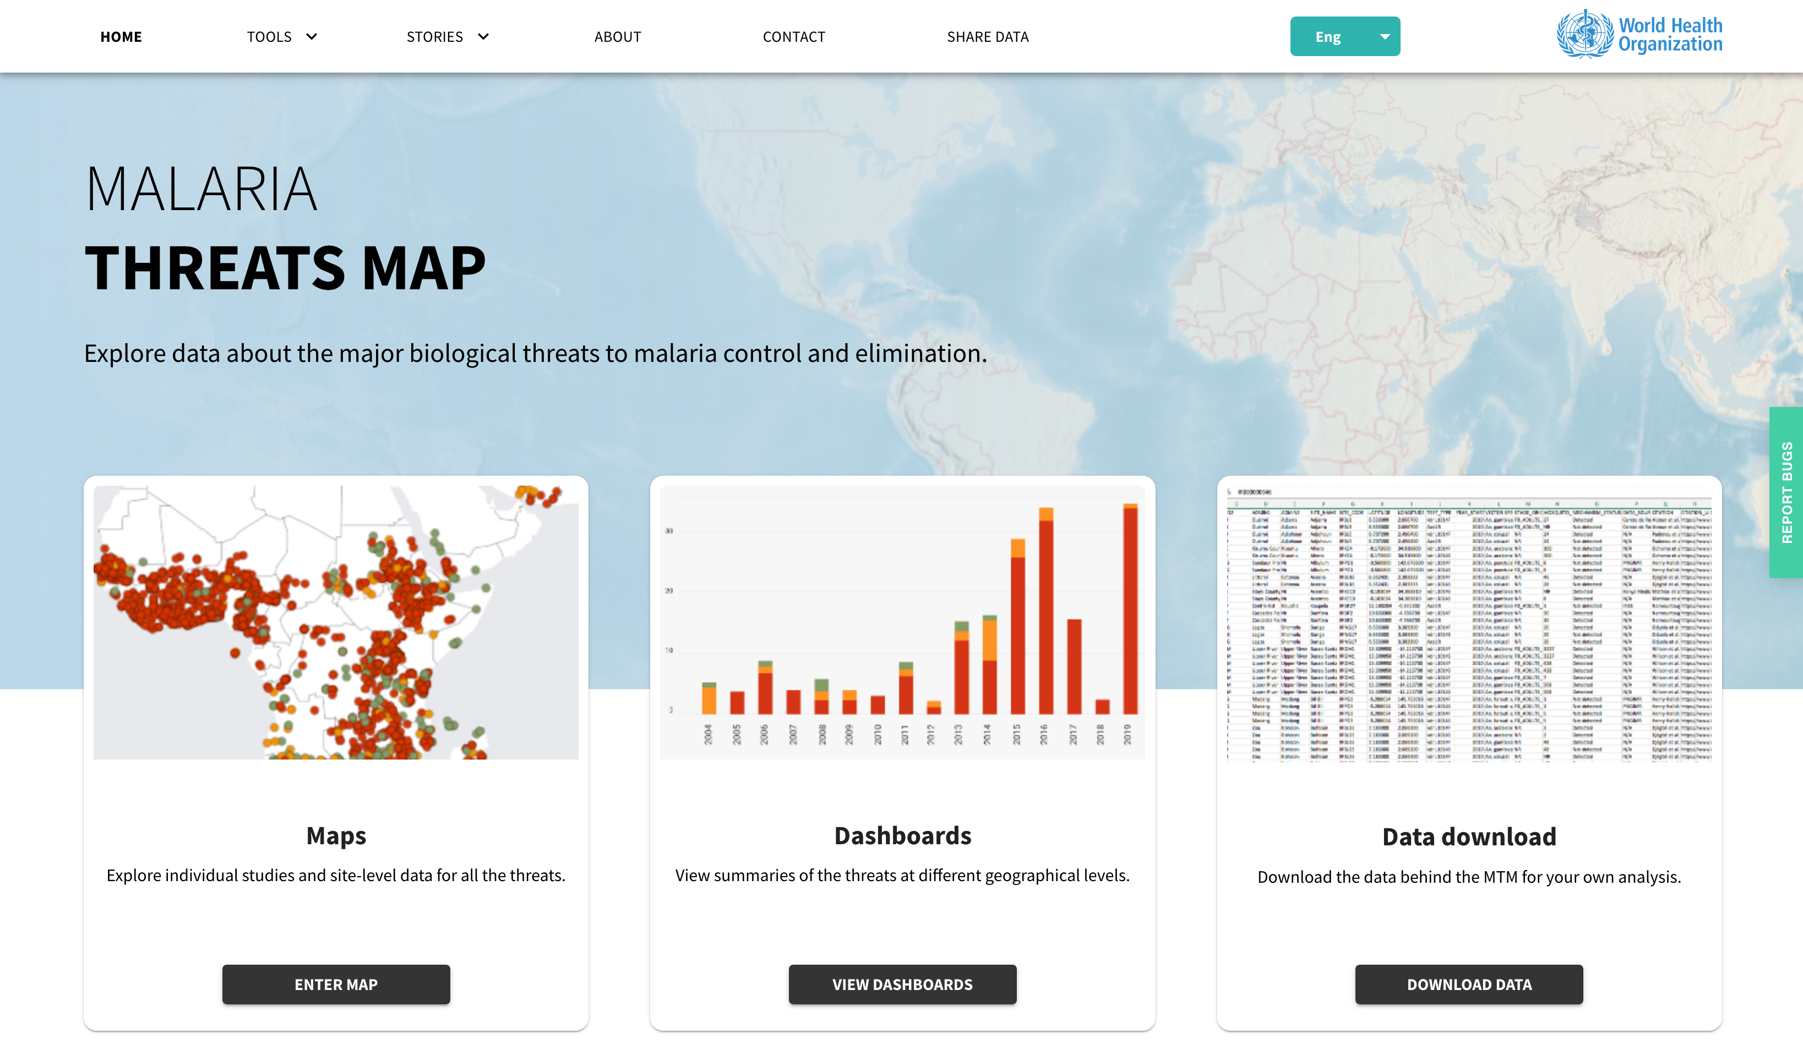
Workshop
RESOURCES: WHO THREAT MAPS

Slide 21
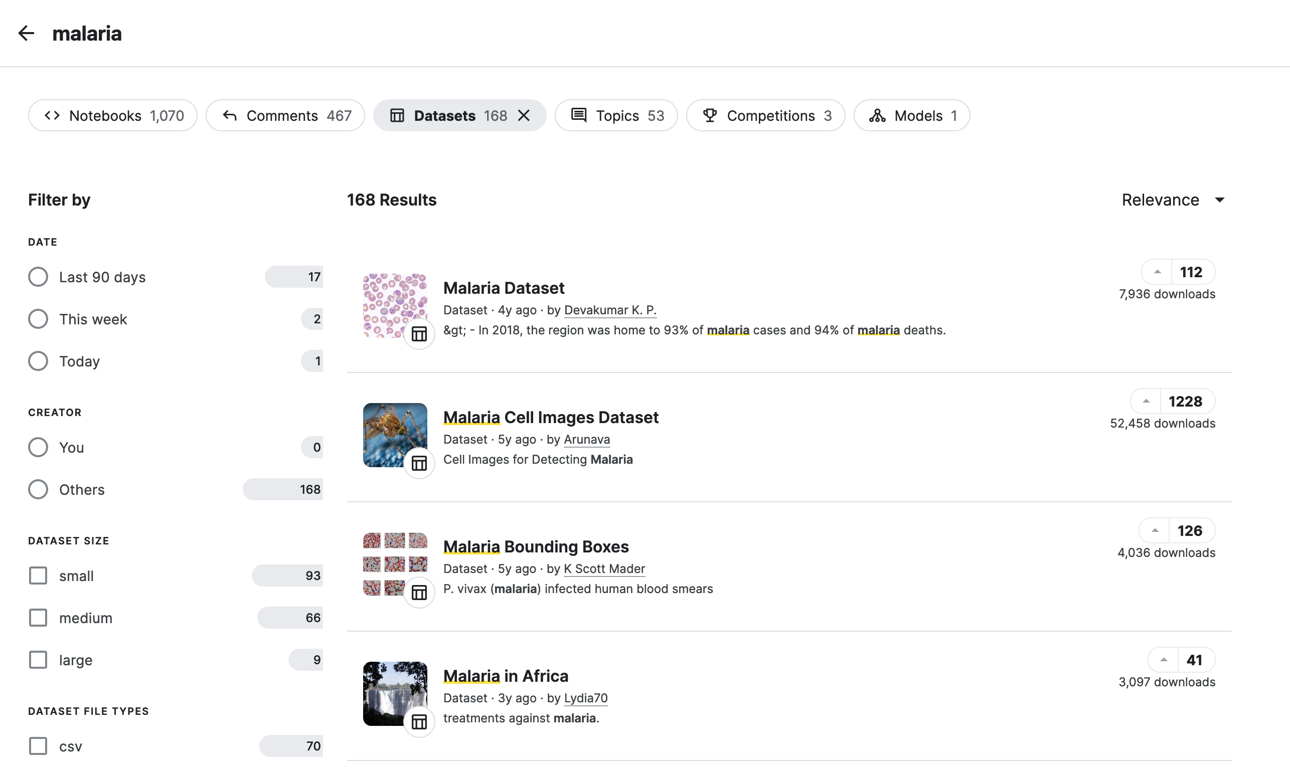
Workshop
RESOURCES: KAGGLE DATASETS

Slide 22
Workshop
RESOURCES: WORLD BANK DATA

Slide 23
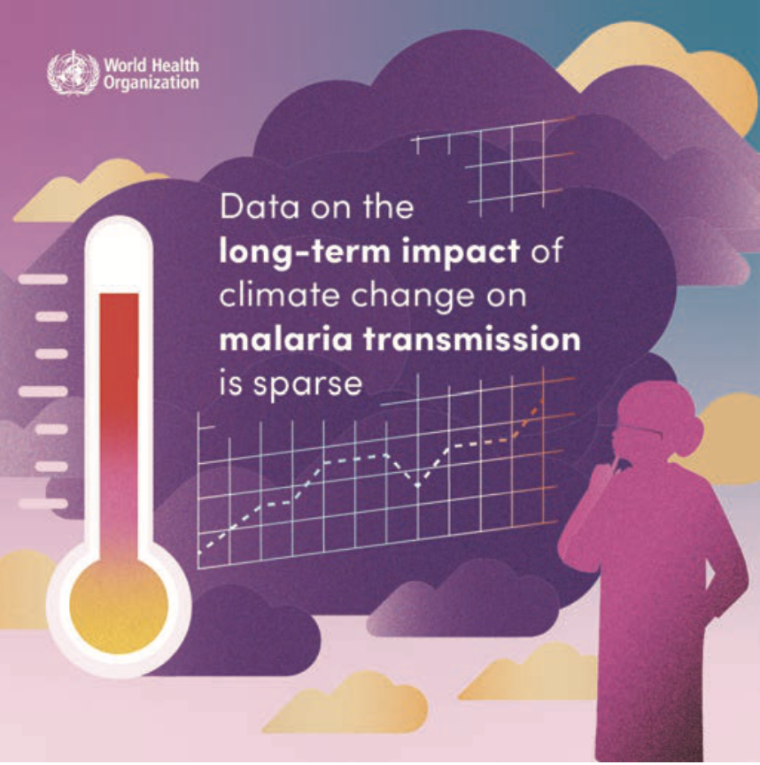
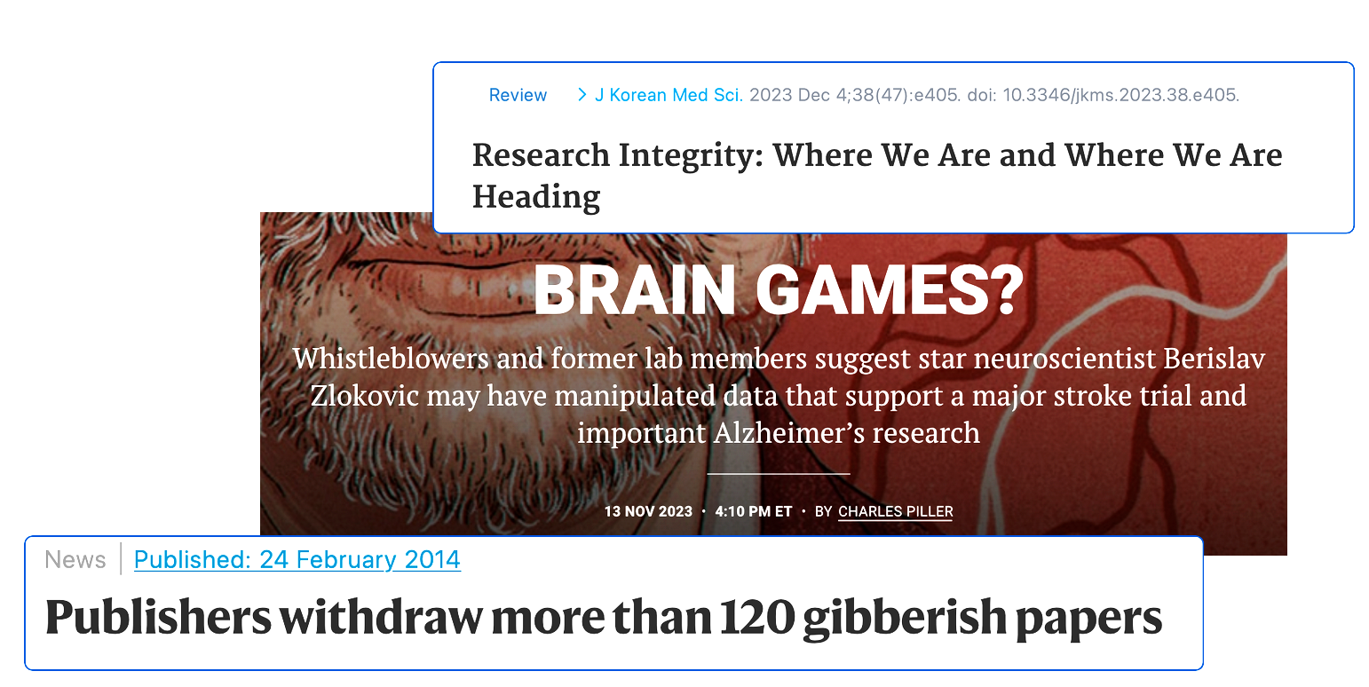
Introduction – Malaria
CHALLENGES
A challenged system
Academia & research structural issues
Data quality & availability
Elimination cost
An ever-evolving disease
Climate change effect
Multi factorial
Local epidemiology

Slide 24
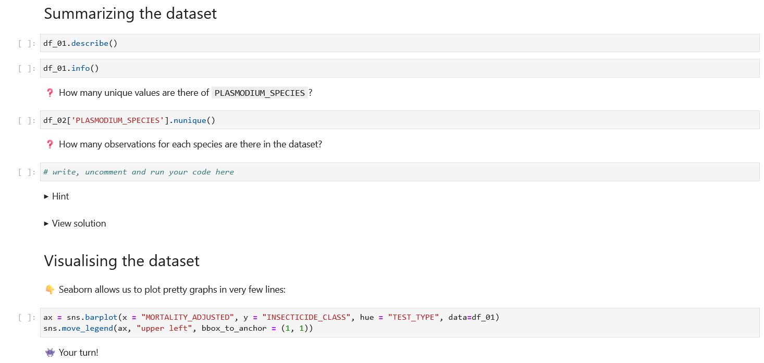
Workshop
PYTHON BASICS

Slide 25
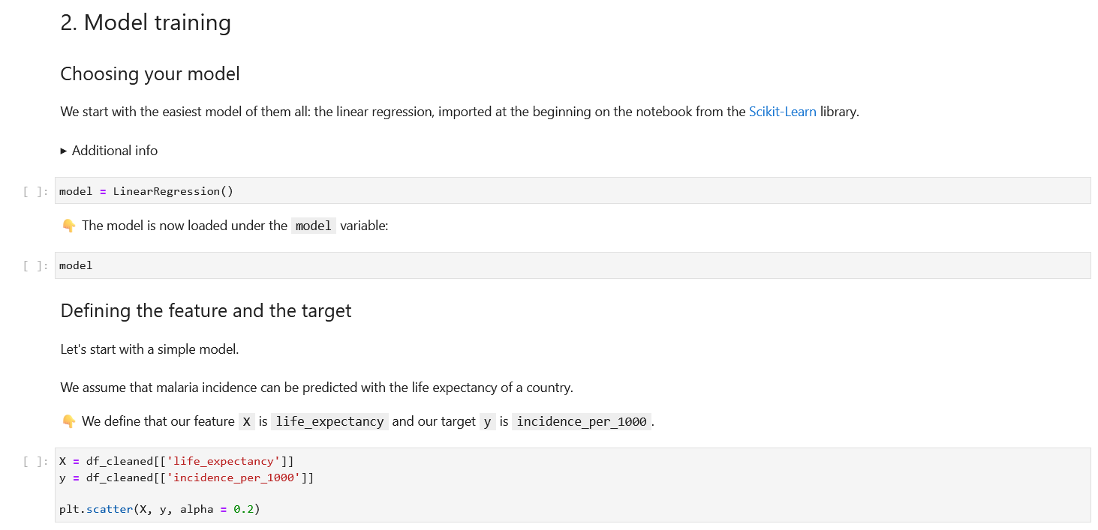
Workshop
GUIDED ML ANALYSIS

Slide 26
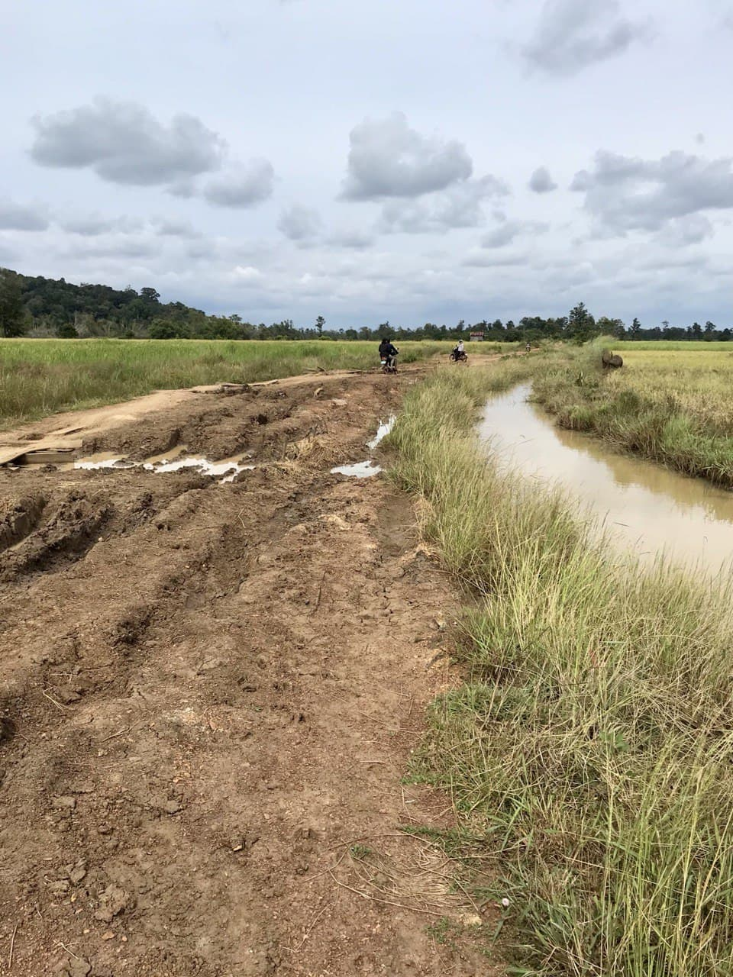
Conclusion
LIMITATIONS
Machine Learning is amazing and nowadays, accessible!
But…
It has limitations
It repeats and increases bias
Maths, ML and AI are great but politics and budget play an important role in most issues

Slide 27
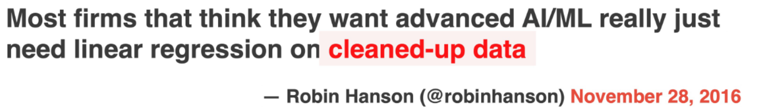
Conclusion
LIMITATIONS

Slide 28
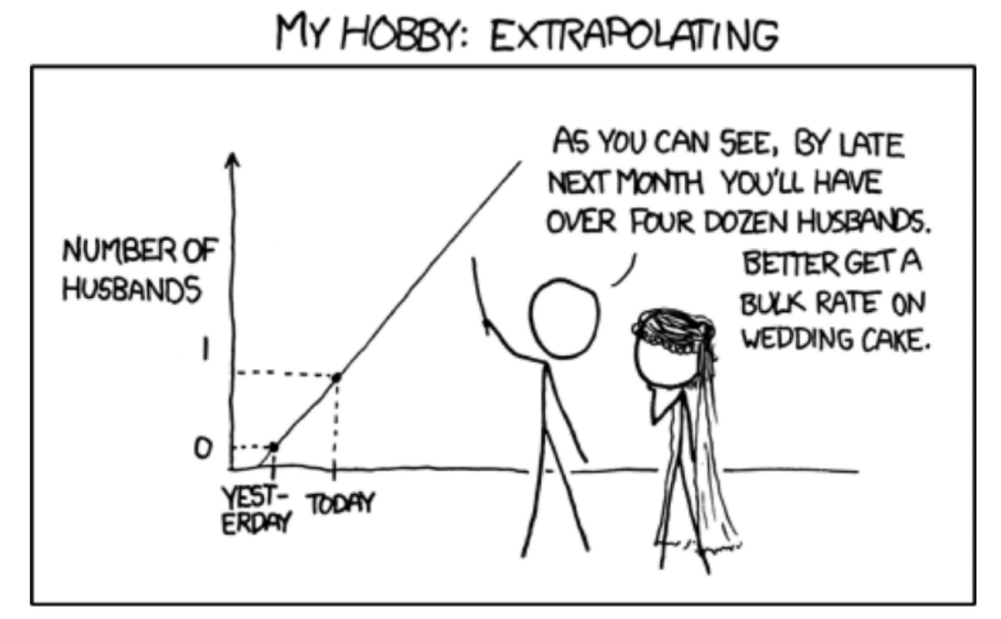
Conclusion
LIMITATIONS

Slide 29
Thank you for your attention!
Questions?

Slide 30
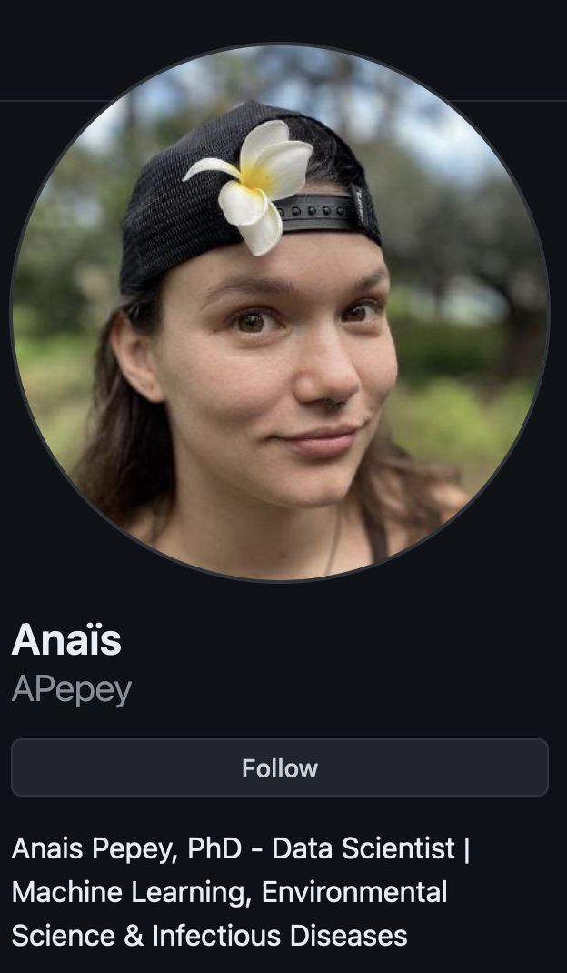

all slides, data and notebooks available on my GitHub
github.com/APepey/ML-workshop

Slide 31
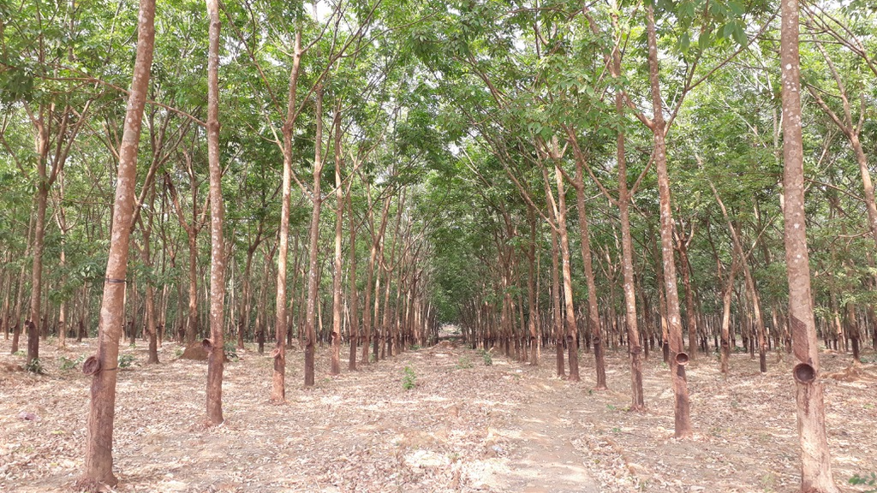

Onto the best part:
mybinder.org/v2/gh/APepey/ML-workshop/main
github.com/APepey/ML-workshop

Slide 32
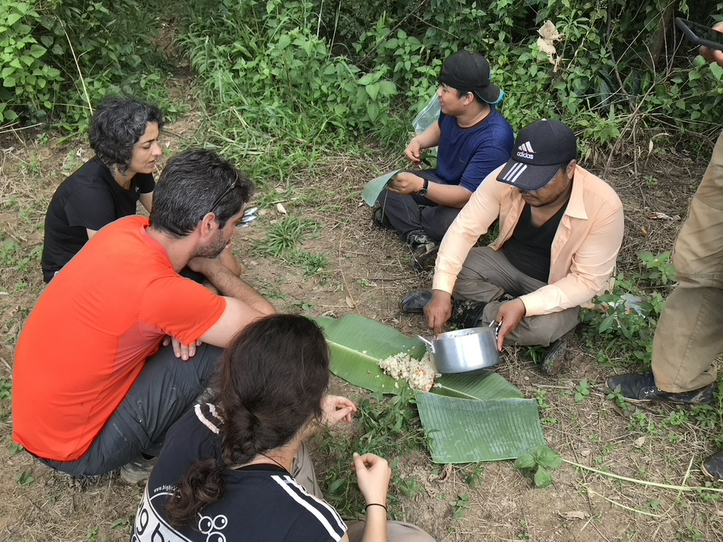
Good job everyone!
Now let’s get some food

Slide 33
Introduction to Machine Learning using open data SUPPLEMENTARY DATA

Slide 34
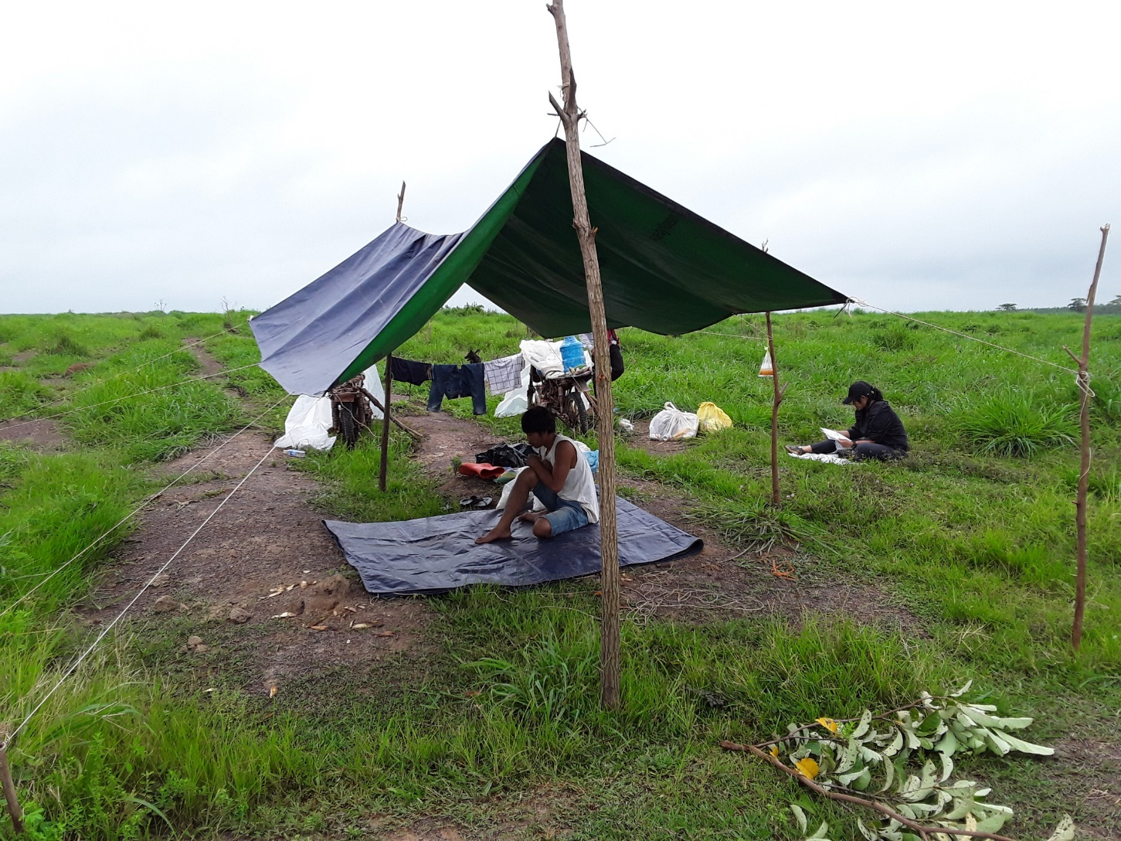
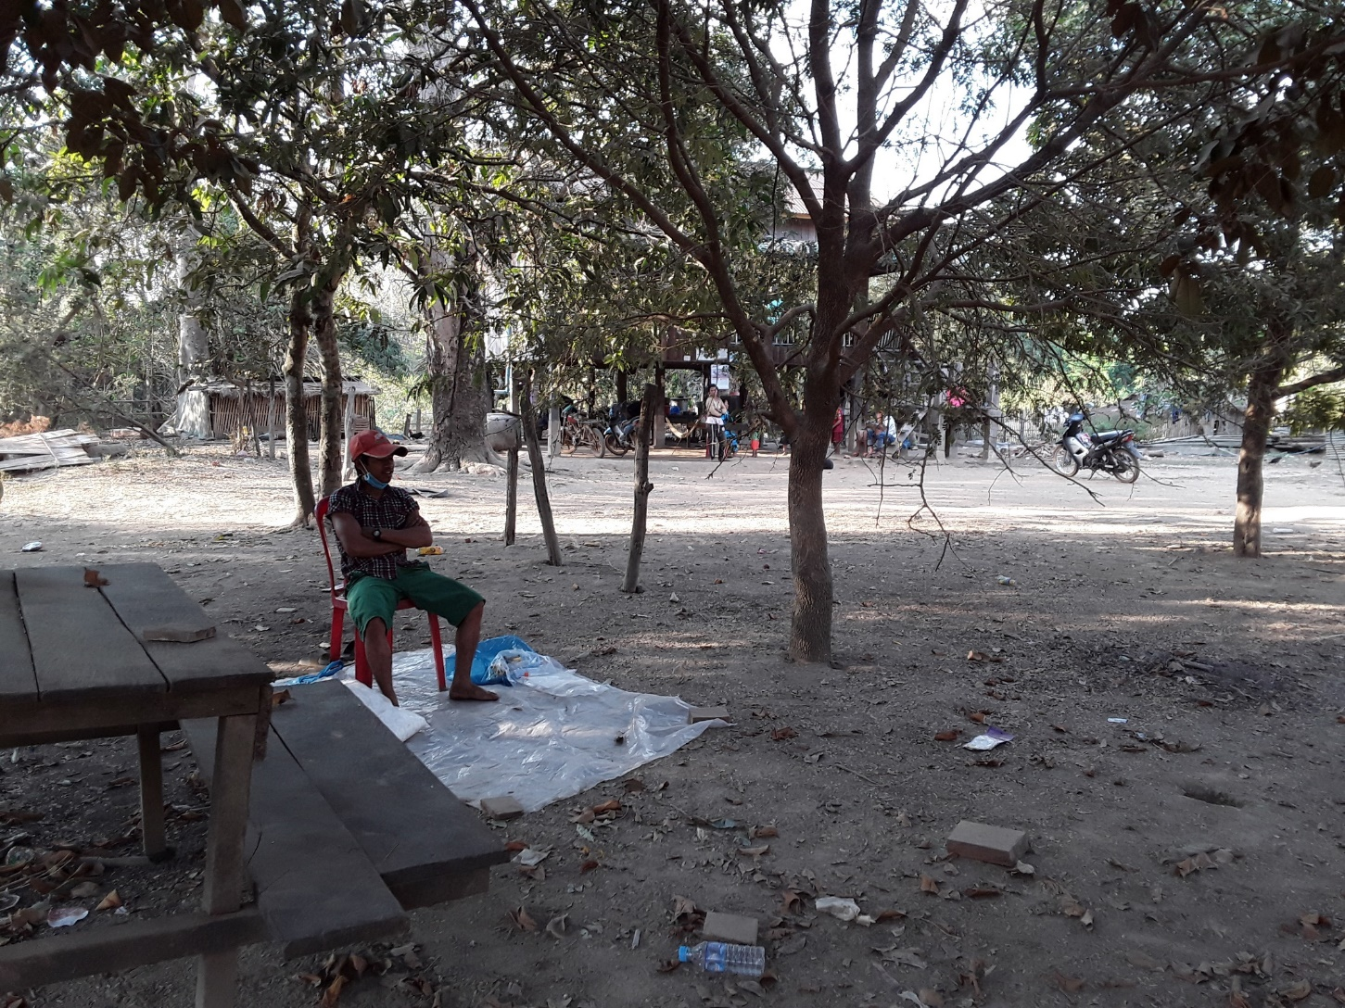
Part II: Ecology and parasite prevalence in vectors
slide
of 39
Material & Methods
Human Landing Catch (HLC)
Aim:
Collect anthropophagic blood-seeking mosquitoes
Methodology:
2 collectors
45 min collection – 15 min rest
Pros:
“gold standard” of mosquito collections, used as reference
Cons:
expose collectors to infectious bites
labour intensive

Slide 35
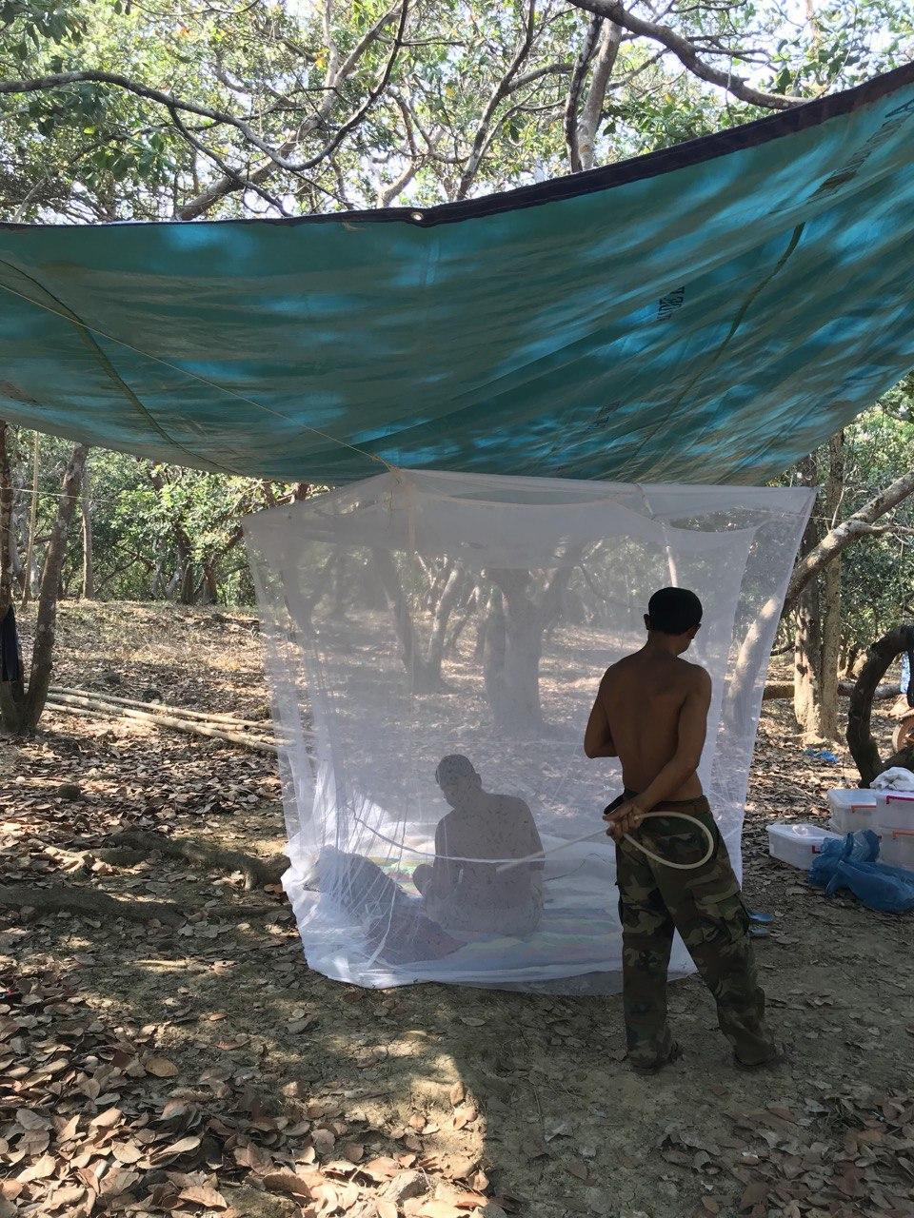
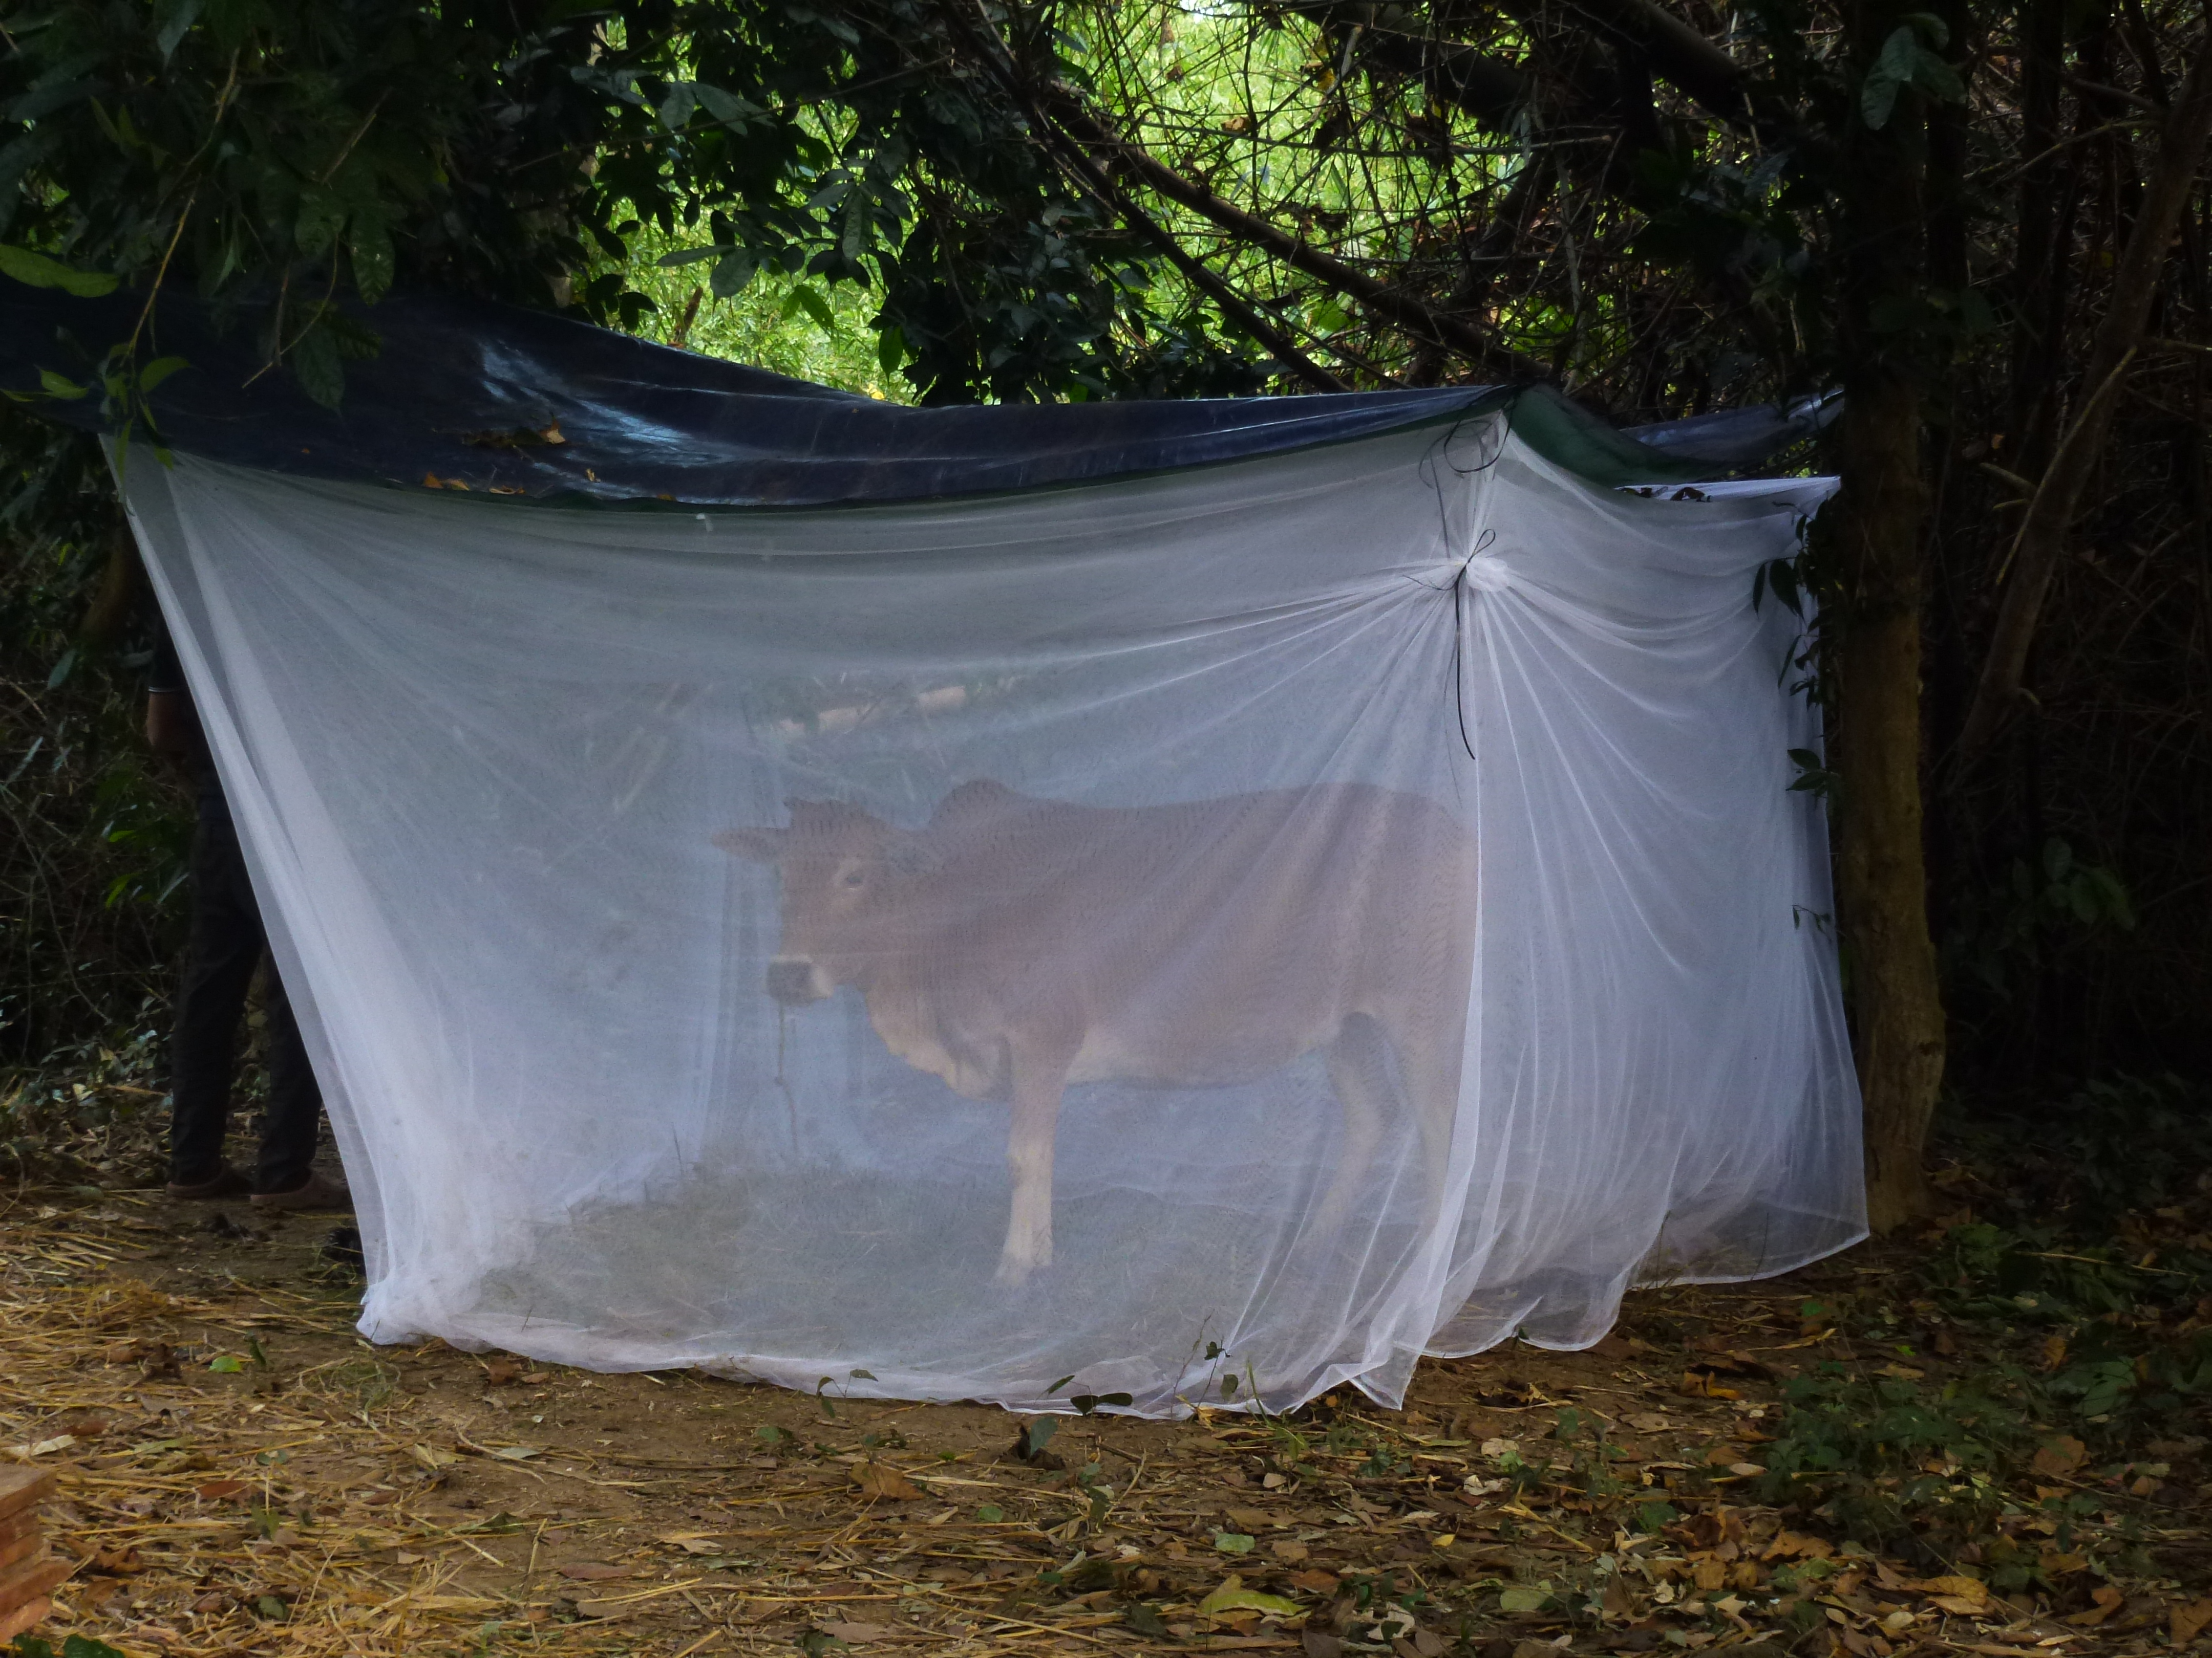
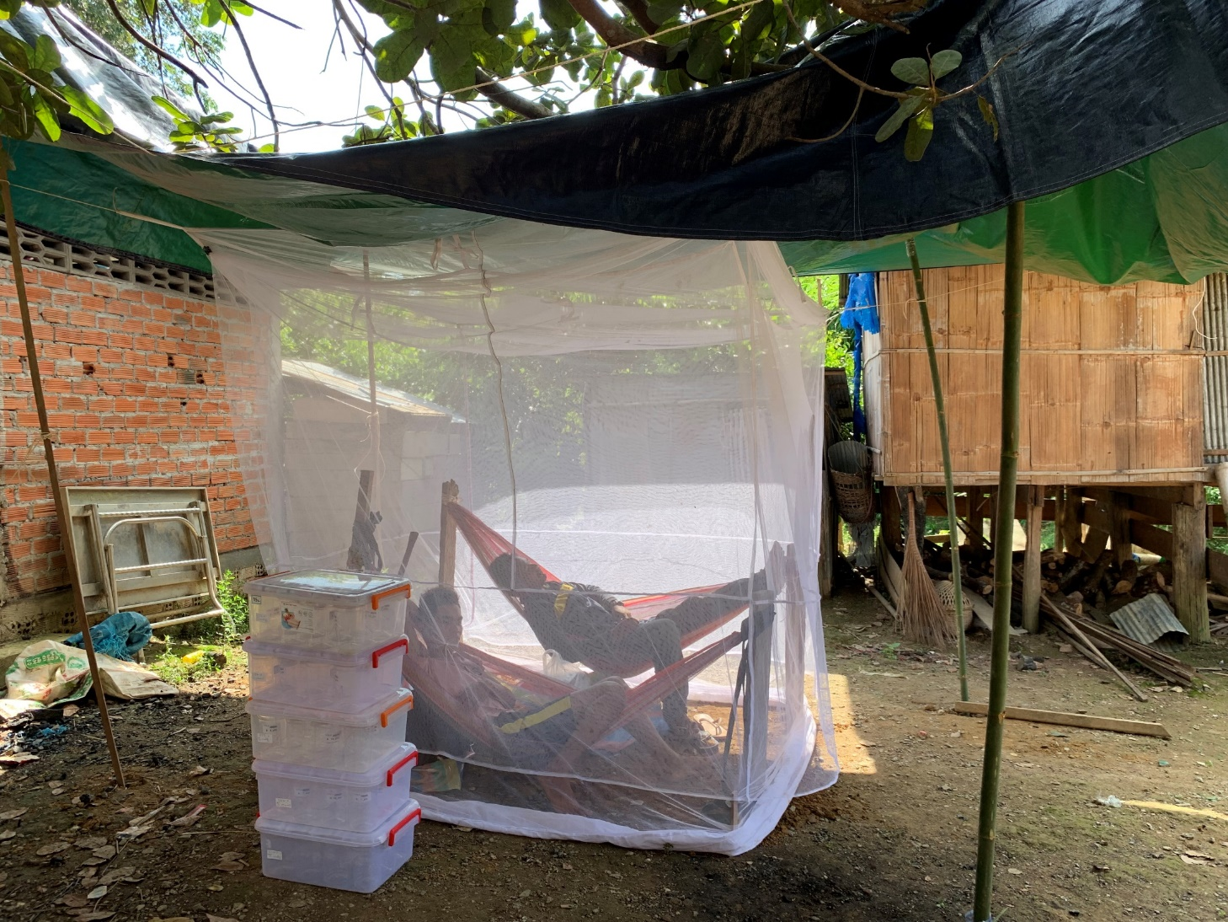
Part II: Ecology and parasite prevalence in vectors
slide
of 39
Material & Methods
Odour-baited Double Net trap
Aim:
Collect anthropophagic or zoophagic blood-seeking mosquitoes
Methodology:
2 collectors
15 min collection – 45 min rest
Pros:
simple & cheap
exposure-free, allows collectors to rest
Cons:
possibly underestimating abundance
collecting shelter-looking mosquitoes
HDN (Human-baited)
CDN (Cow-baited)

Slide 36
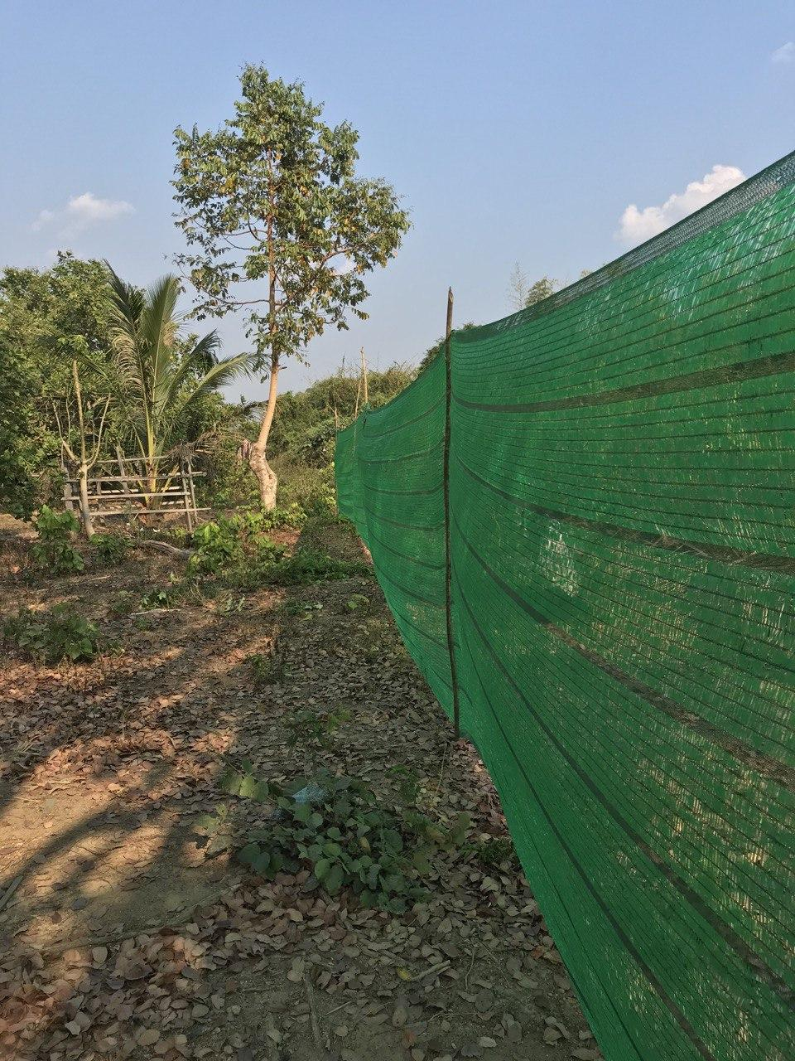
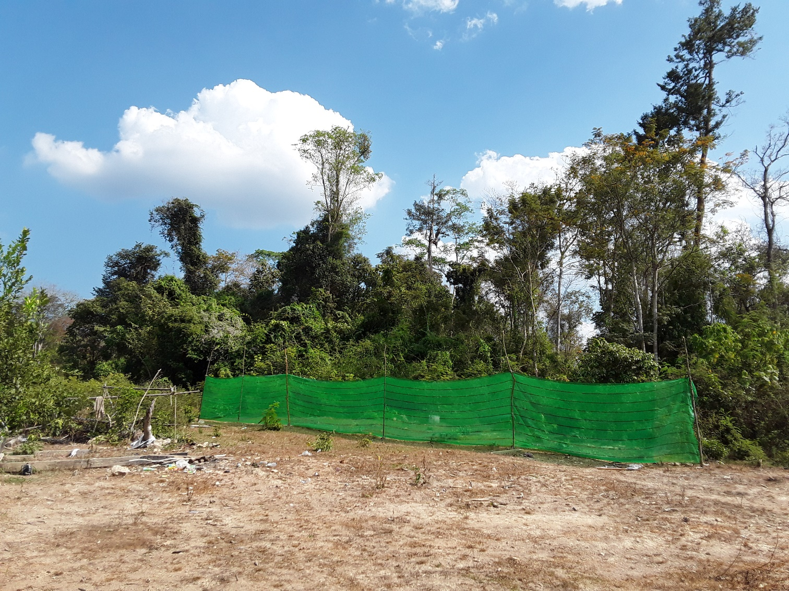
Part II: Ecology and parasite prevalence in vectors
slide
of 39
Material & Methods
Barrier Screens (SCR)
Aim:
Determine mosquito flight periods and direction: “interception traps”
Methodology:
2 groups of 2 collectors
15 min collection – 45 min rest
Pros:
simple & cheap
exposure-free, allows collectors to rest
Cons:
mosquitoes avoiding and flying off the screen

Slide 37
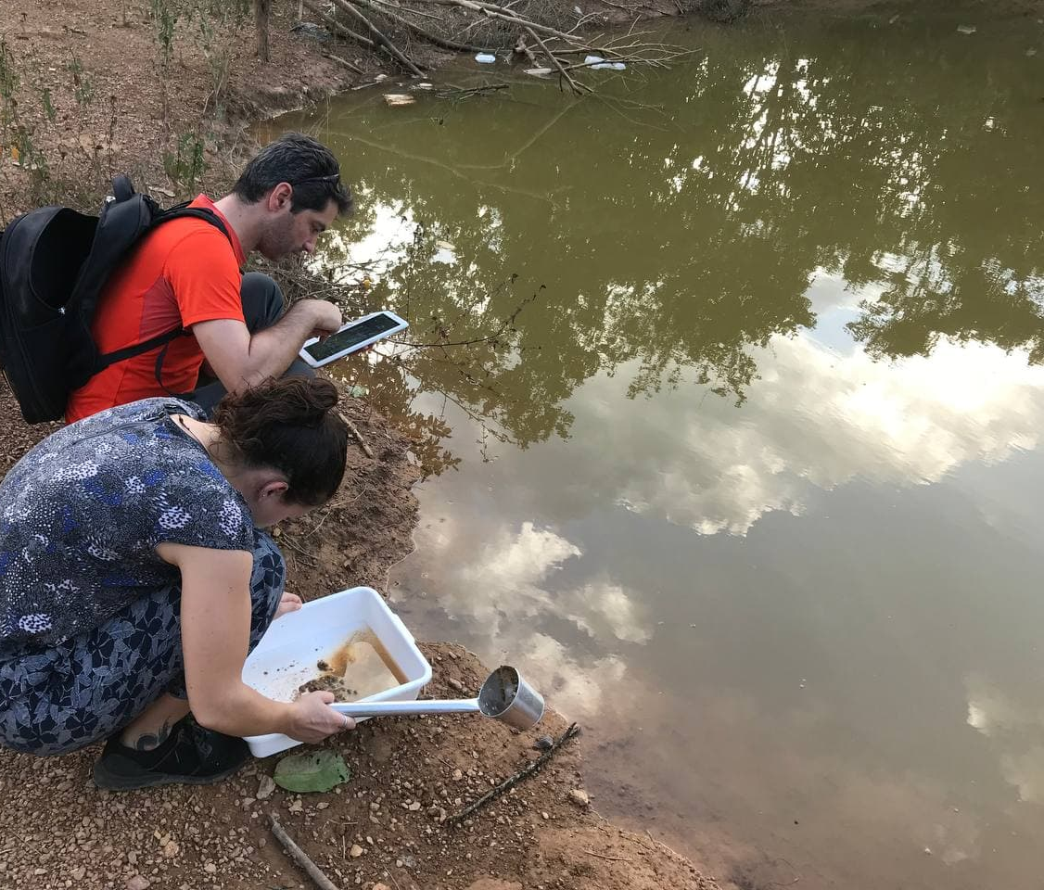
Part II: Ecology and parasite prevalence in vectors
slide
of 39
Material & Methods
North
Aquatic habitats transects
Aim:
Collect larvae and describe their habitat
Methodology:
sampling and describing all water bodies along a precise transect
Pros:
extensive knowledge of potential breeding sites
well-defined limits & reproducible
Cons:
time-consuming
inaccessibility of some breeding sites
100m
HDN trap
2m
Sampling a breeding site with a dipper and a tray to find larvae, and describing it using a REDCap questionnaire
Transect structure: a 100m rope is extended
in every cardinal direction

